Slide 1
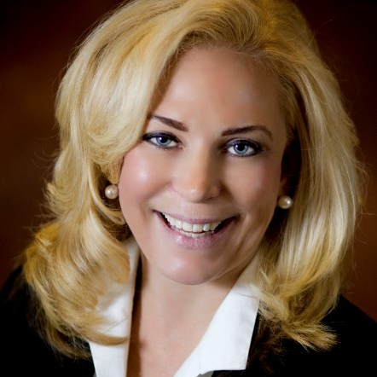
Innovate and Optimise: A Digital Twin of Business Operations With Dr. Natalie Petouhoff

Slide 2
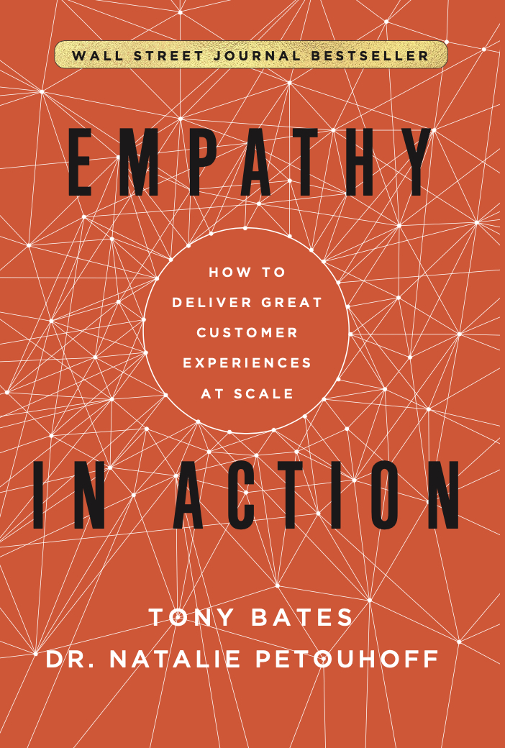
Dr. Natalie Petouhoff
AI, Customer Experience, and Future of Work Expert
WSJ Best-Selling Author of Empathy in Action: AI and Customer Service
Ph. D. Engineering, UCLA
Innovation & Disruptive Strategies, Harvard
Dr. Natalie Petouhoff

Slide 3
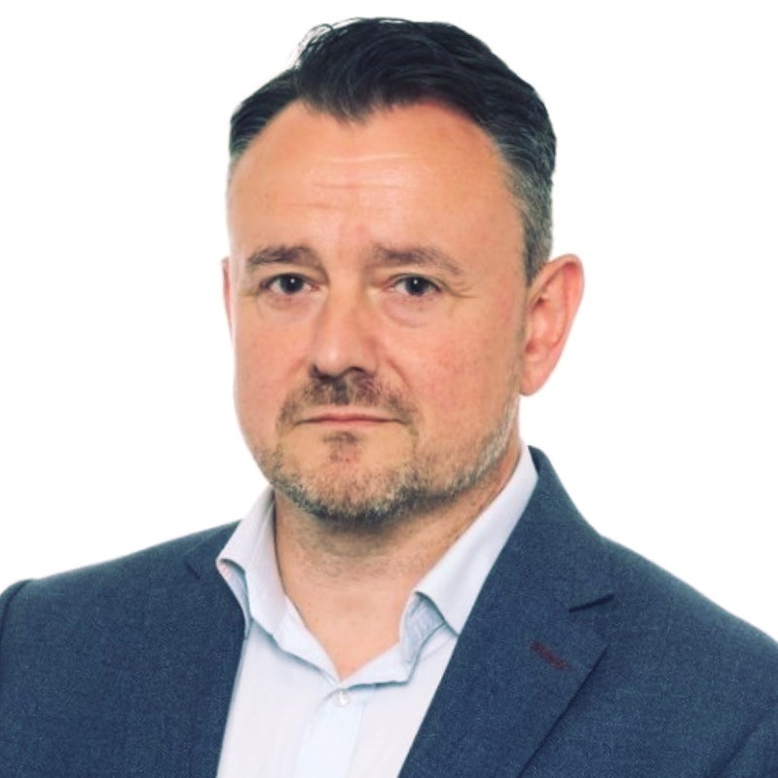
What is a Digital Twin of Business Operations?
Dean Jehan | Principal Consultant | Davies

Slide 4
A digital twin is a virtual replica of a physical system, process or product that can be used to simulate, monitor and analyse its behaviour and performance, and model change.
In the context of an organisation, a digital twin could represent all or part of an entire operating model, including all of its connected processes, assets, resources, and stakeholders.

Slide 5
“
Creating an Operational framework in a platform such as BusinessOptix provides us a powerful opportunity to start identifying and modelling opportunities in our organisation, risk free, in ways we never-before thought possible.
“

Slide 6
Demonstration

Slide 7
Case Study Davies US
Digital Twin to support Service Business Transformation

Slide 8
Situation
Implication
Davies US acquiring new service businesses at pace
High complexity integrating people, processes and technology
Demand for integration increasing
Increased risk of backlog in discovery and solution design
Increased analysis complexity and costs

Slide 9
Our Challenges
Our business analysis methods are evolved but…
Still reliant on traditional applications such as Visio and MS Excel
Outputs have limited reuse beyond individual projects
We needed a solution to reduce complexity, centralise operational IP and increase speed to value

Slide 10
What we did
Built a reusable operational framework for CX improvement
Mapped out service operations inc. pain points and opportunities
Better strategic planning and implementation of change
Reusing Digital Twin for initiatives such as service & org re-design and introducing new technology
Providing a reliable single source of truth for US transformation
What we achieved

Slide 11
“
The Digital Twin has reduced time spent on scoping, planning and delivering optimisation initiatives by over 50%, while significantly reducing complexity, risk and cost
“

Slide 12
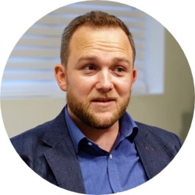
Building the foundations of a Digital Twin
Travis Bristow
Chief Innovation Officer & VP Technology
BusinessOptix

Slide 13
The Power of a Process Repository in Building a Digital Twin

Slide 14
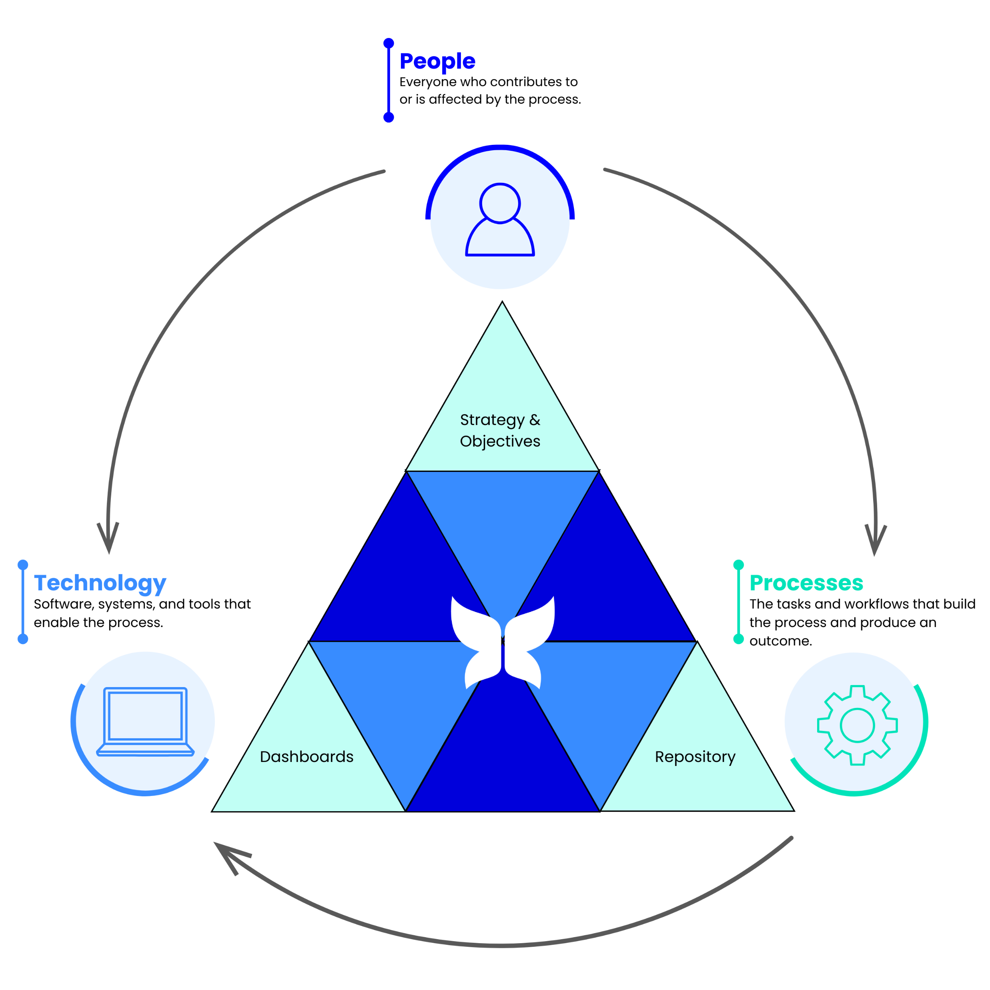
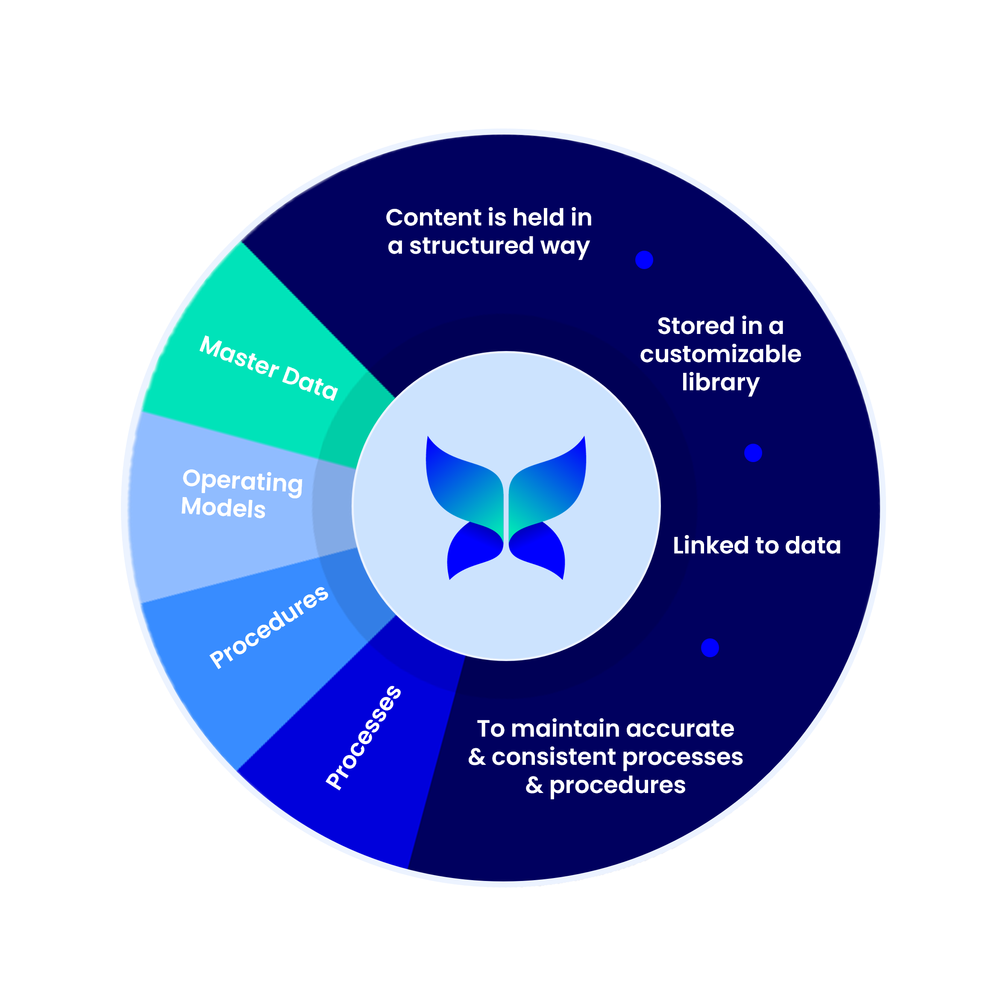
A digital twin is a digital representation of a real-world entity or system. The implementation of a digital twin is an encapsulated software object or model that mirrors a unique physical object, process, organization, person or other abstraction. Data from multiple digital twins can be aggregated for a composite view across a number of real-world entities, such as a power plant or a city, and their related processes.
“We now have documented processes, along with insights about master data for roles and systems, a way to illustrate how/what is changing/transforming and moving towards having an operational twin of our environment.”
Enterprise Architecture, Technology Innovation & Integration Director
MIT Lincoln Laboratory
Notes:
To explain why a repository is important, let’s first explain what it is.
Definition
Enter CoPilot… and yes, that really is only my second reference to AI. ☺
A Business Process Repository (BPR) is a central location for storing information about how an enterprise operates. It houses details related to business processes.
* Talk over the Repo Circle *
All interconnected and queryable,
Governed and Quality Controlled
* Quote from a customer *

Slide 15
Let’s take this up a level
Notes:
Let’s go up a level one more time.

Slide 16
Removing the complexity
Notes:
What might this look like for an organisation?
Top – Dashboards, Strategic reports measuring the Dollars & Cents, or frankly any of the metrics that a business uses to evaluate its performance.
2nd – The Coal Face, the Customer Experiences of your products and services, along with all other external stakeholders, perhaps even the environment that drive these metrics.
1st – The Management of the employee experience, along with any supporting resources that are deployed.
Finally – The processes and operations that make the proverbial sausage, ensure its quality, and bring it to market.

Slide 17
Case Study

Slide 18
What business challenges were you looking to solve?
Lack of process standardisation
Siloed working
Multiple fragmented tools & repositories
Centralized process management

Slide 19
What was your BPM vendor evaluation process?

Slide 20
1
2
3
Internal investigations and advice from Gartner led to an initial shortlist of 11 BMP software vendors
Created a Level 1 Council to agree requirements and evaluate vendor offerings
Reducing the list down to 8 and then finally 3 vendors
4
5
6
Final stage vendor customer consultations
MIT Lincoln Laboratory interviewed as a customer of BusinessOptix
BusinessOptix selected

Slide 21
Where did you start with BusinessOptix?

Slide 22
Level 2 Council
Level 3 Council
Customer-to-Customer Learning
The decision was made to continue the relationship with MIT Lincoln Laboratory, learning from their experience in building their BusinessOptix Digital Twin.
Established to discuss and decide upon key elements such as:
Master Data roles and deployment.
How to connect processes to work instructions/SOPs and customer journeys.
Controls and verifications between process owners (authors) and users (participants).
Established to prioritise and plan adoption of further BusinessOptix capabilities such as:
Simulation
Governance, Risk and Compliance (GRC)

Slide 23
What benefits do you expect to realise?

Slide 24
Process Standardisation & Centralisation
Continuous Improvement
Reduced Inefficiencies & Leveraging AI
No more disparate processes created and stored in different tools such as Visio and SharePoint. There will be one single source of accessible truth across all businesses.
The ability to use simulation to identify areas to improve and scenario test before making business changes.
Utilise process mining to identify bottlenecks and inefficiencies to help streamline processes. Spotting areas of opportunity to use AI to improve ways of working and resource utilisation.

Slide 25
Feel free to ask questions using the chat function

Slide 26
We are offering 1 lucky winner
A free day of Digital Twin workshops to map a service in your organisation
Visual outputs showing your business and service on a page
Reports with pain points and opportunities to improve your CX

Slide 27
Scan the QR code to register your interest in our offer

